Slide 1

From MCP to Agentic AI
Knowledge Transfer

Slide 2


Model Context Protocol

Slide 3
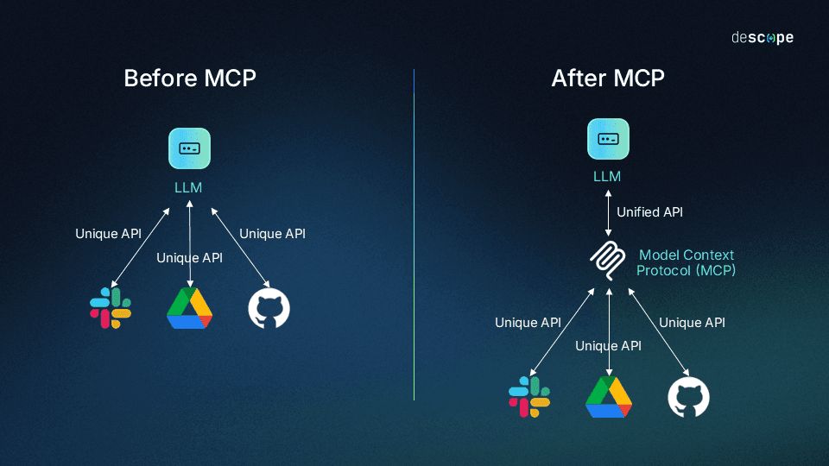
Model Context Protocol

Slide 4
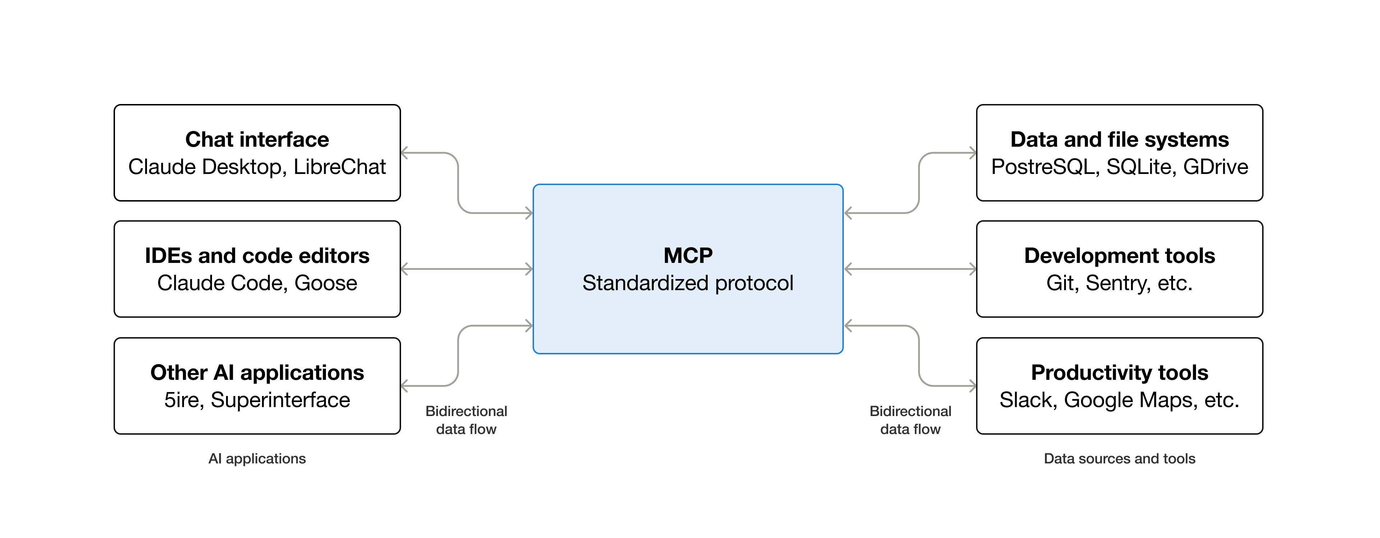
Model Context Protocol

Slide 5
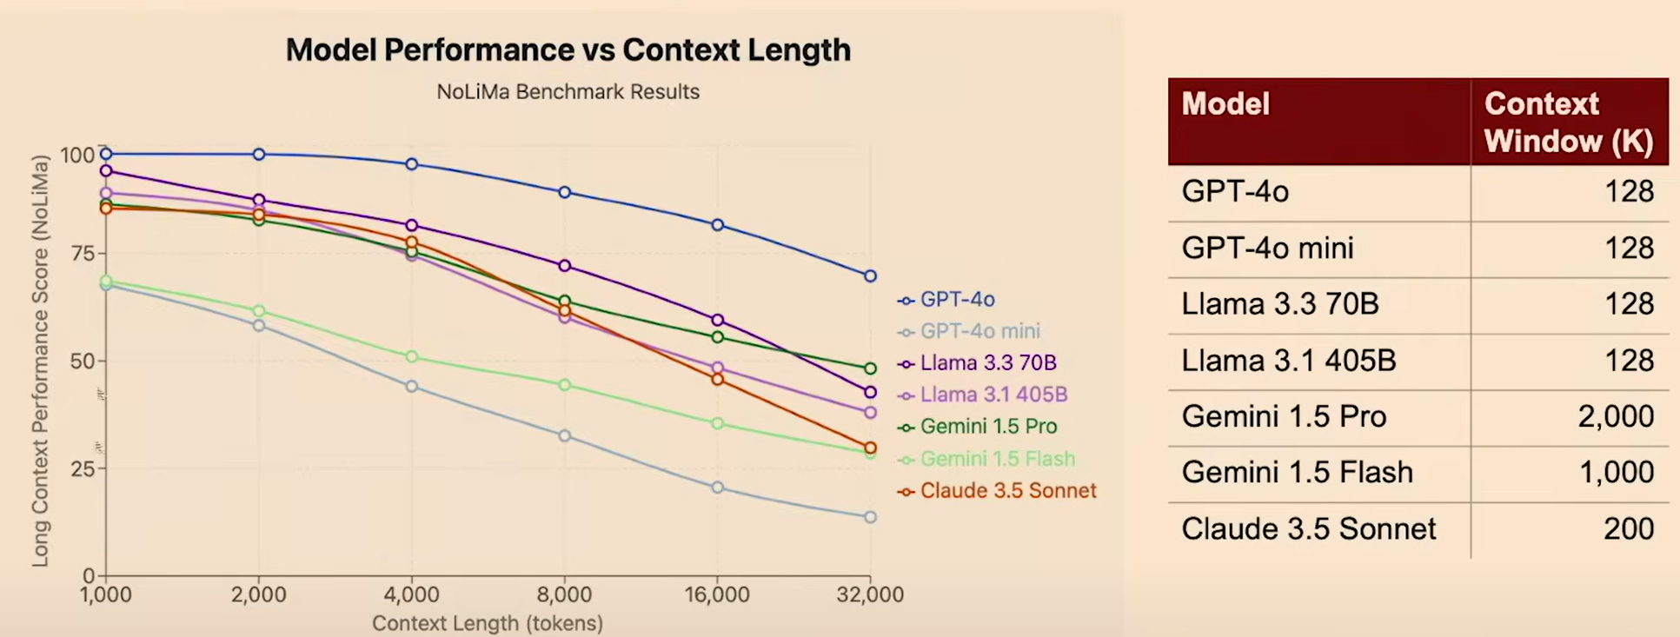
Context Engineering

Slide 6
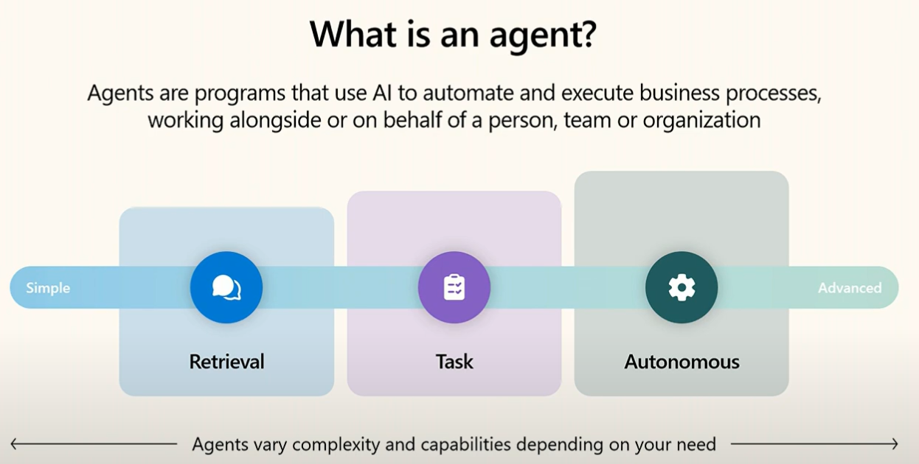
Agentic AI

Slide 7
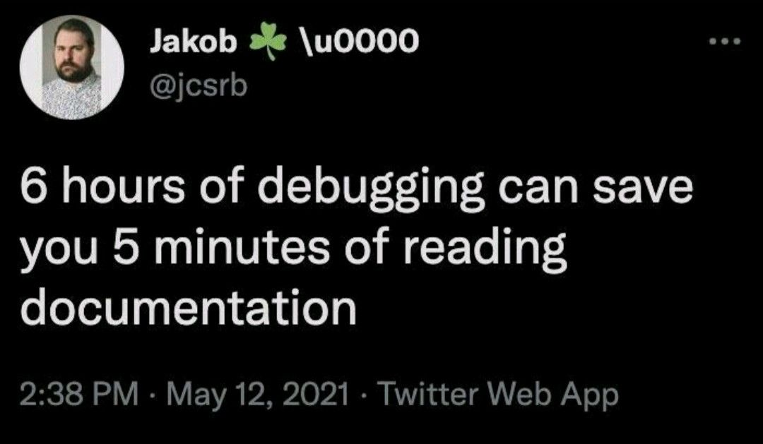
MCP Core Concepts
MCP Specification
MCP SDKs: TypeScript, Python, Java, Kotlin, C#, Go, PHP, Ruby, Rust, Swift
MCP Development Tools
MCP Reference Implementations
Documentation
modelcontextprotocol.io

Slide 8

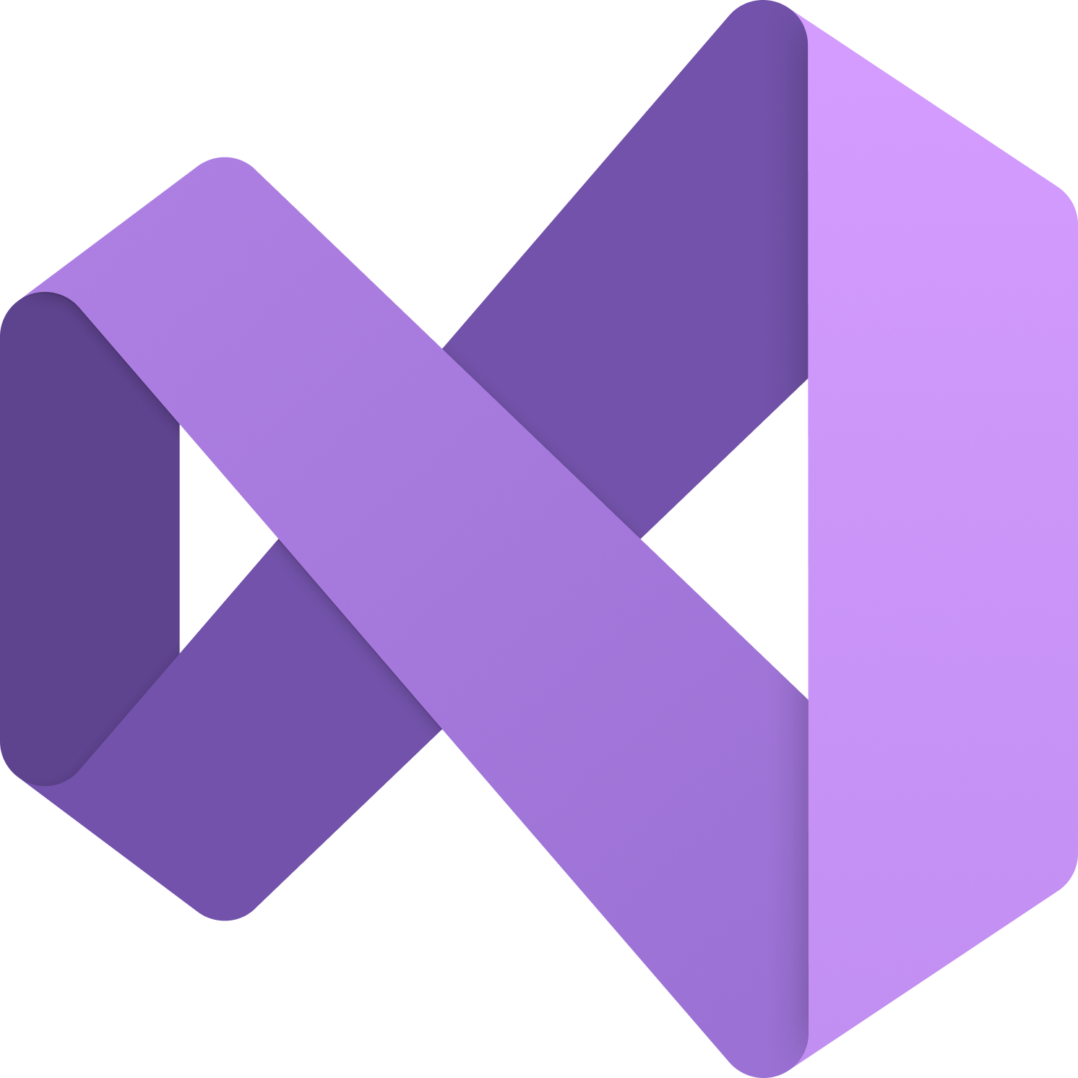
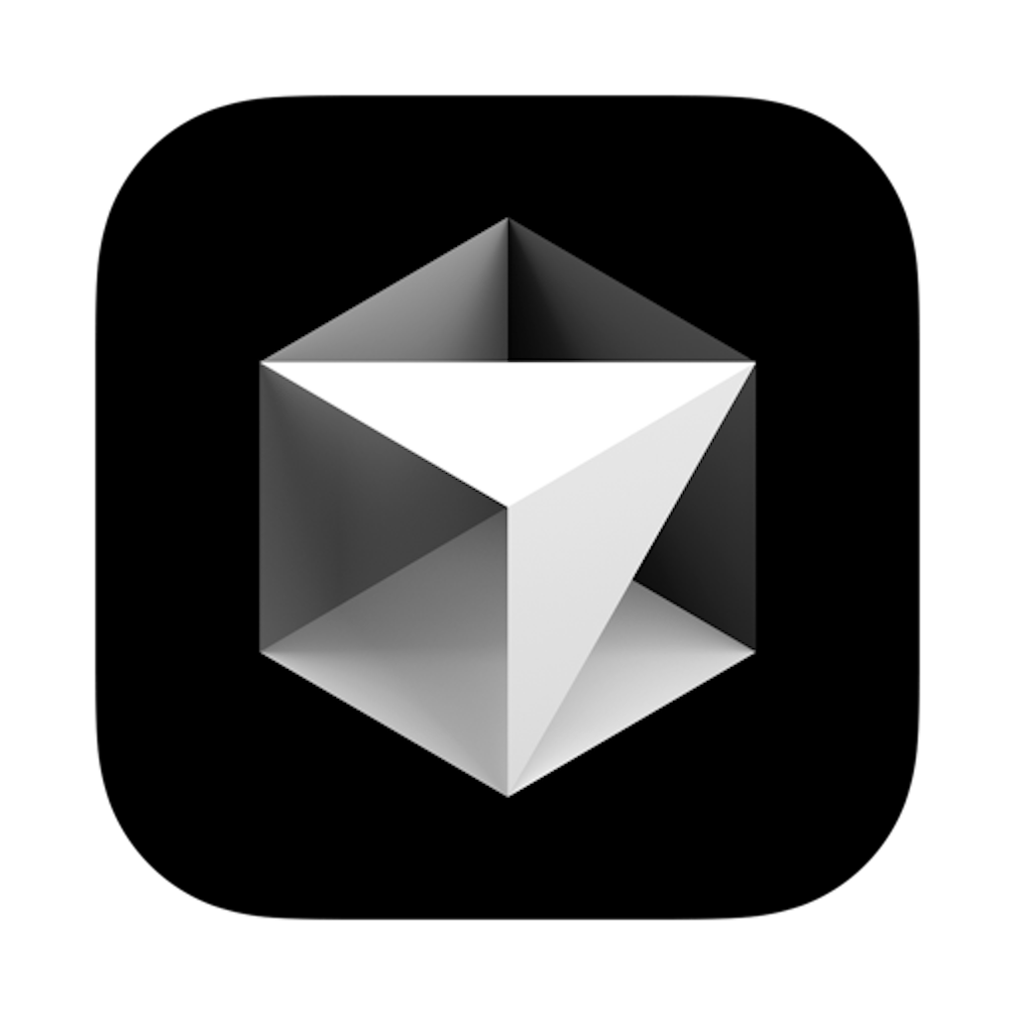



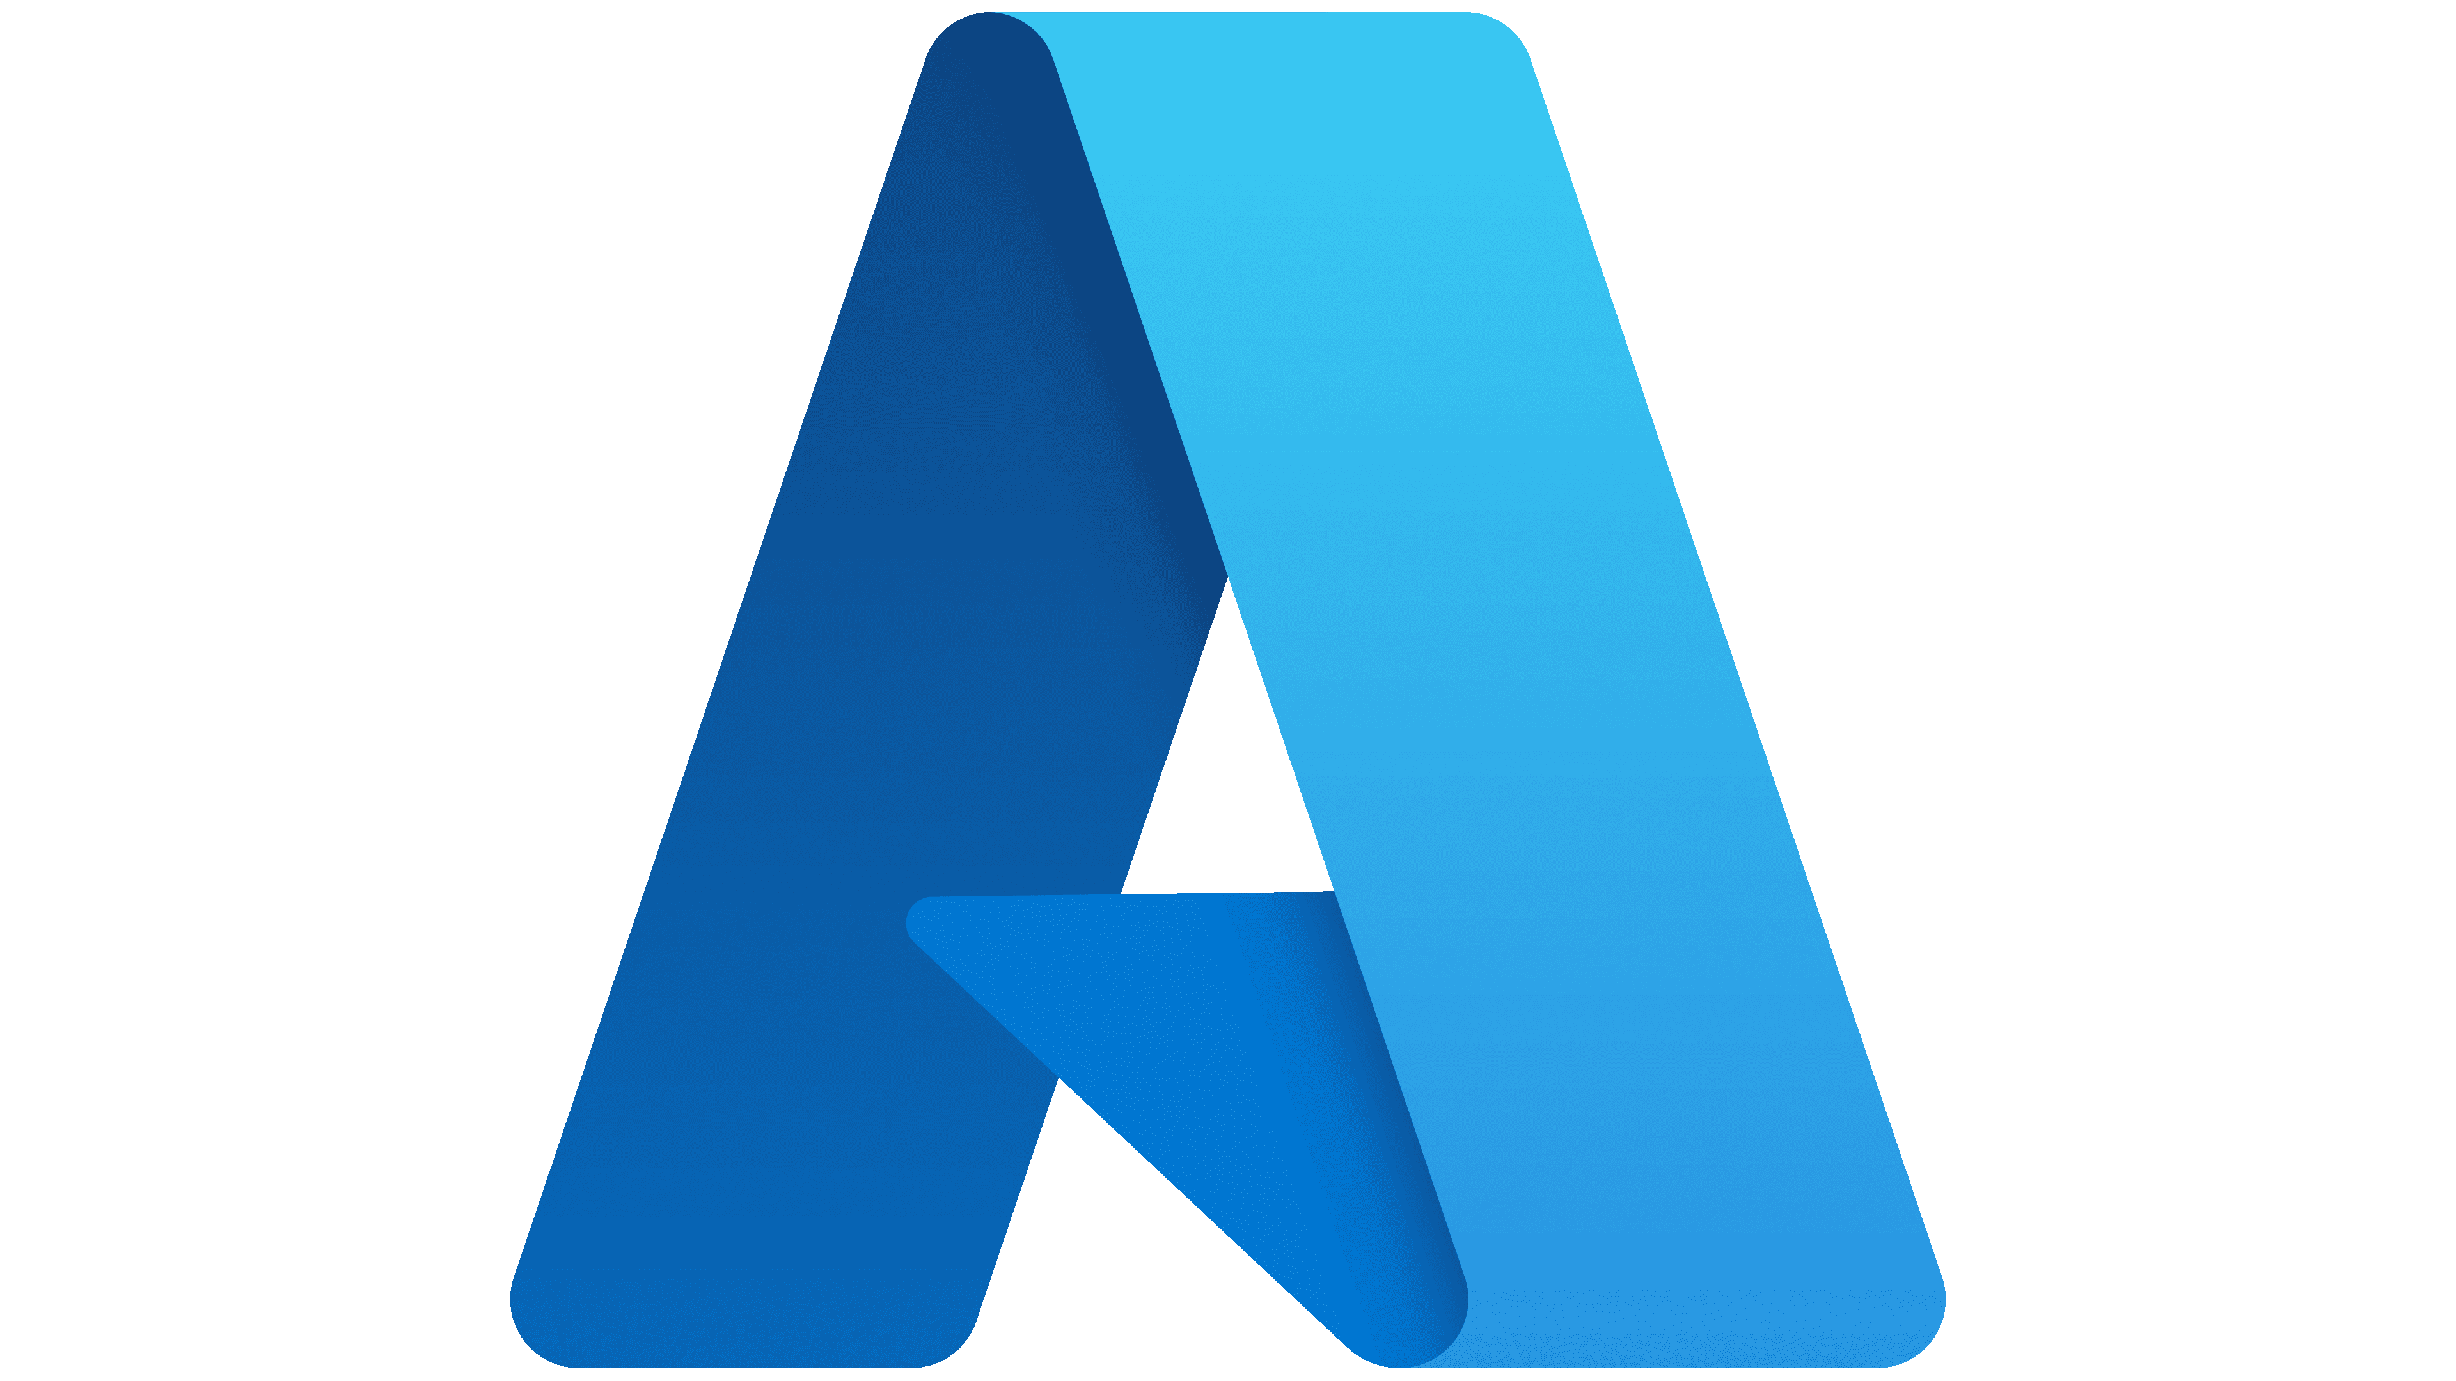


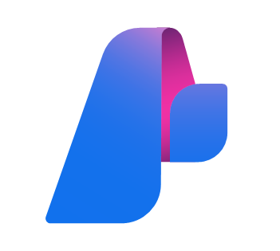







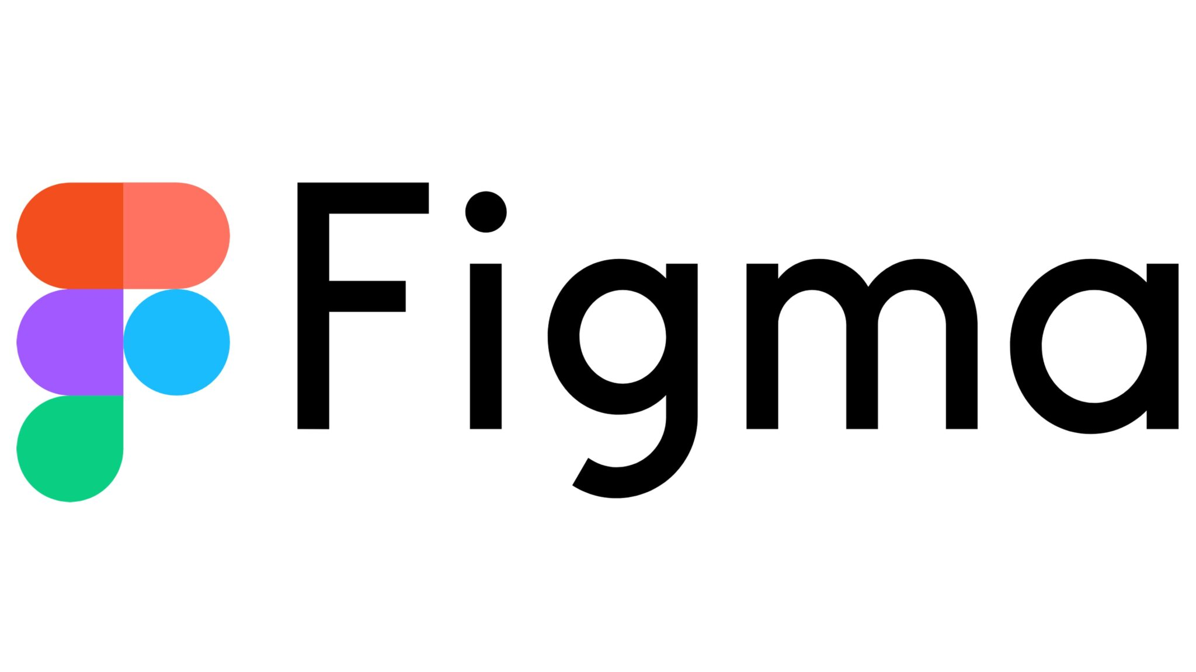
MCP Participants
Hosts
Clients
Servers

Slide 9
MCP Layers
Transport layer
Stdio transport (LOCAL)
Streamable HTTP transport (REMOTE)
Data Layer (JSON-RPC 2.0)
Lifecycle management
Server features
Client features
Utility features (Notifications)

Slide 10
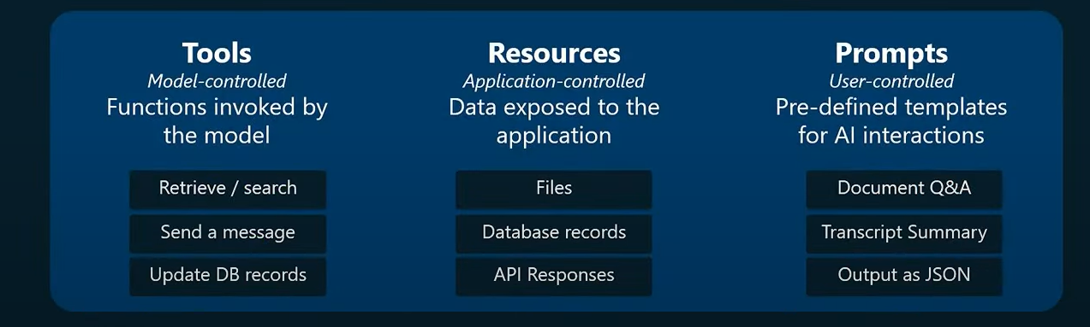
MCP Primitives

Slide 11
MCP Client Primitives
Sampling
Elicitation
Roots
Logging

Slide 12
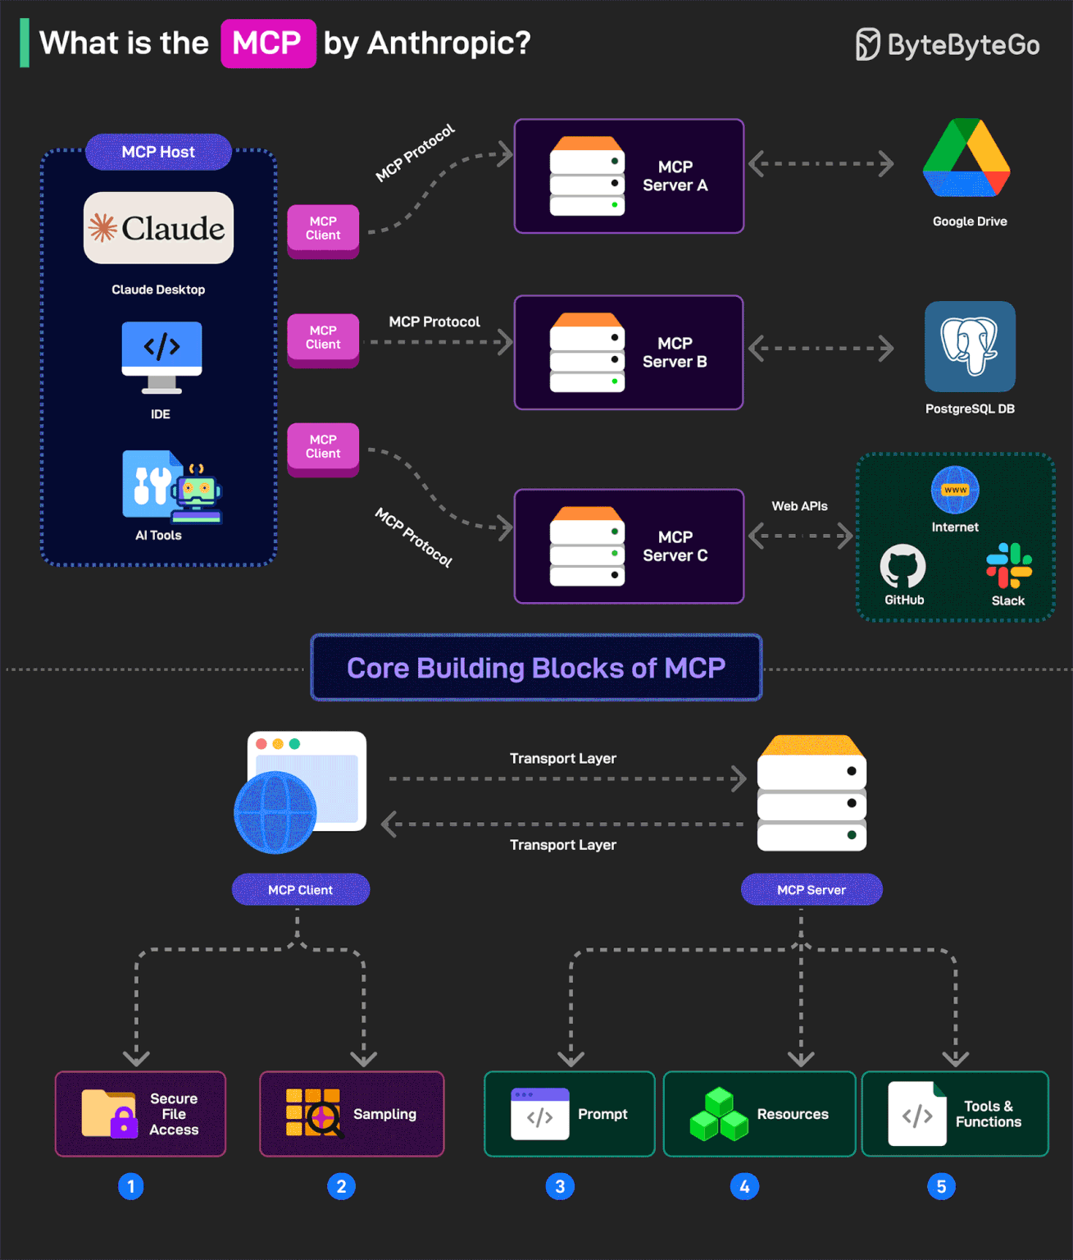
MCP Client Primitives

Slide 13
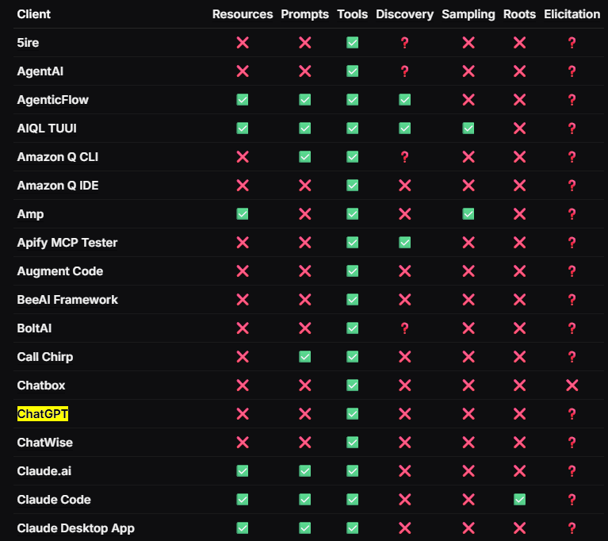
MCP Feature support

Slide 14
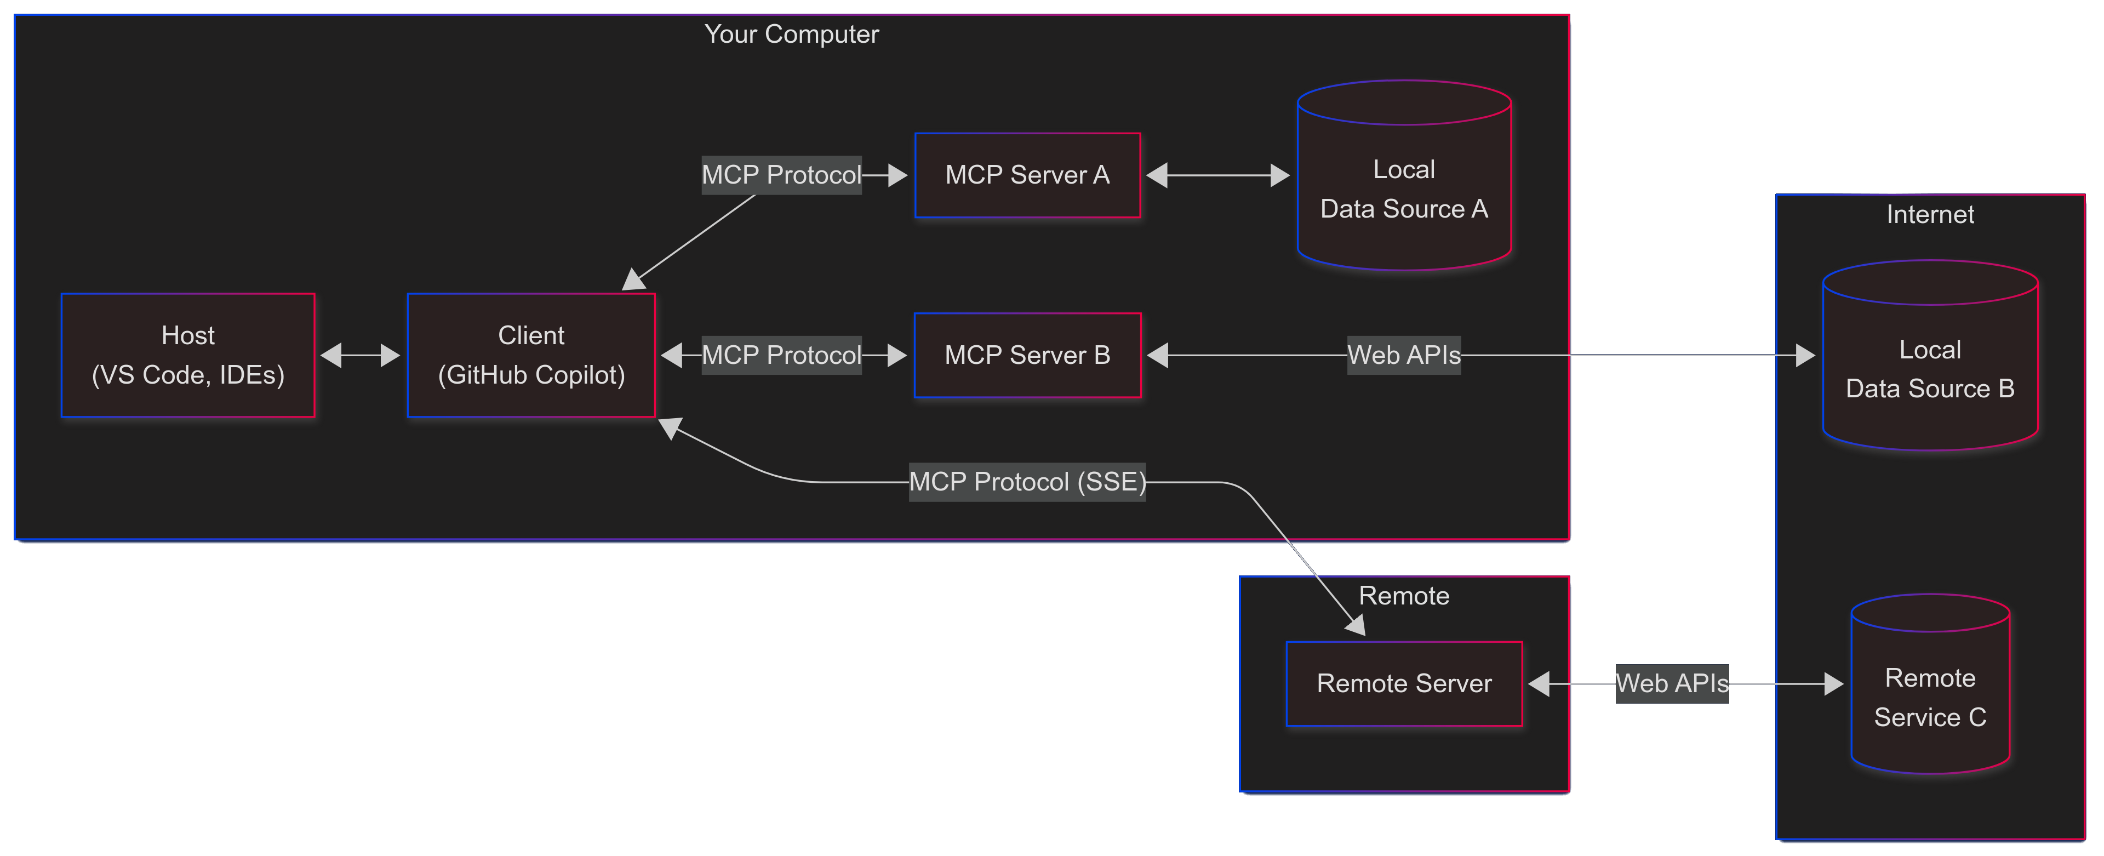


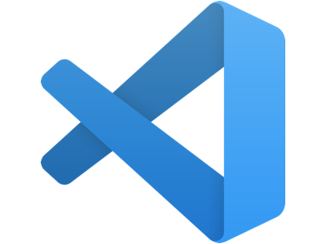



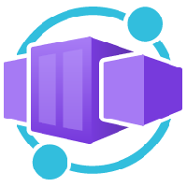

MCP client-server interaction

Slide 15
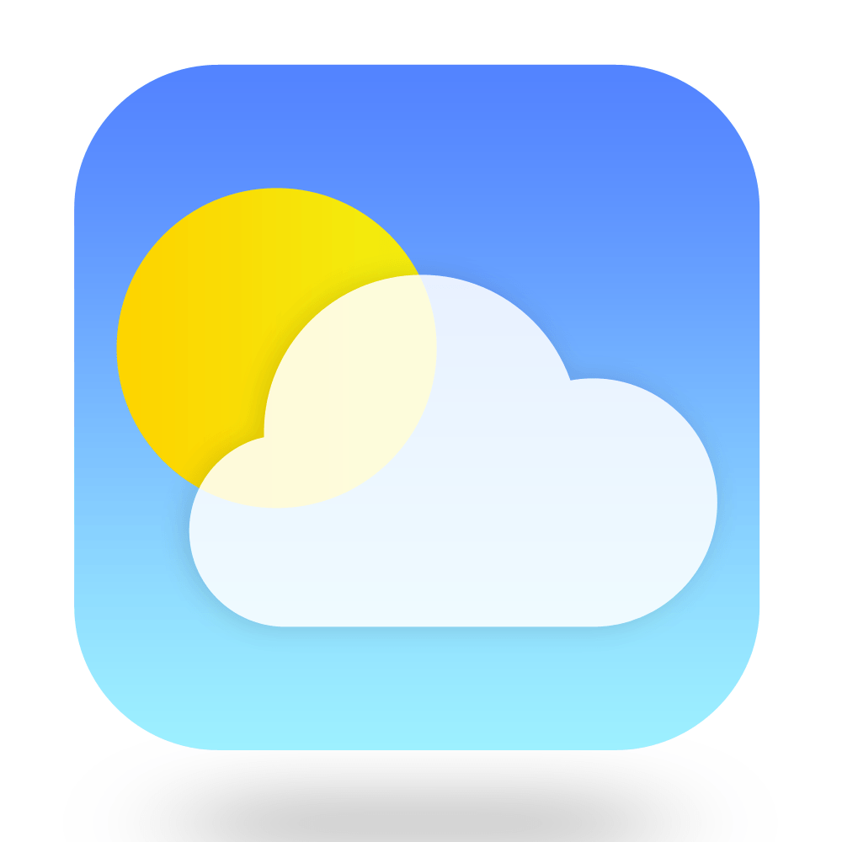
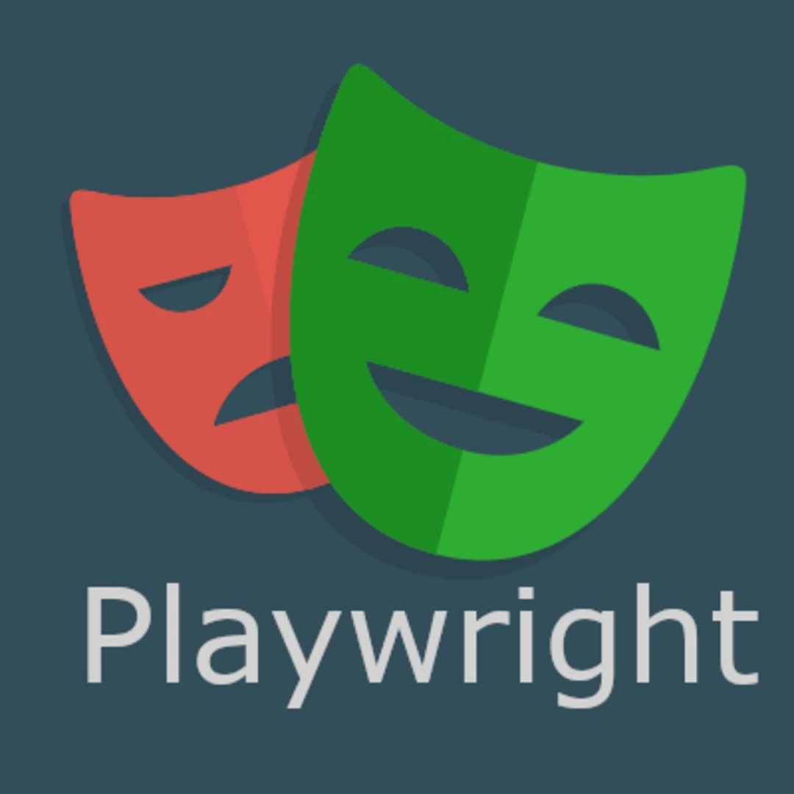

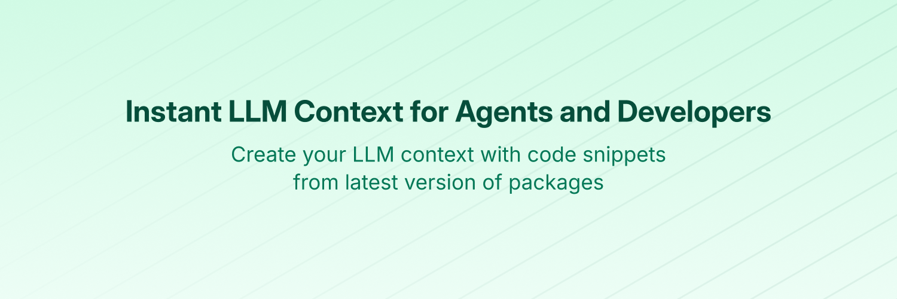

DEMO

Slide 16

Productionise

Slide 17
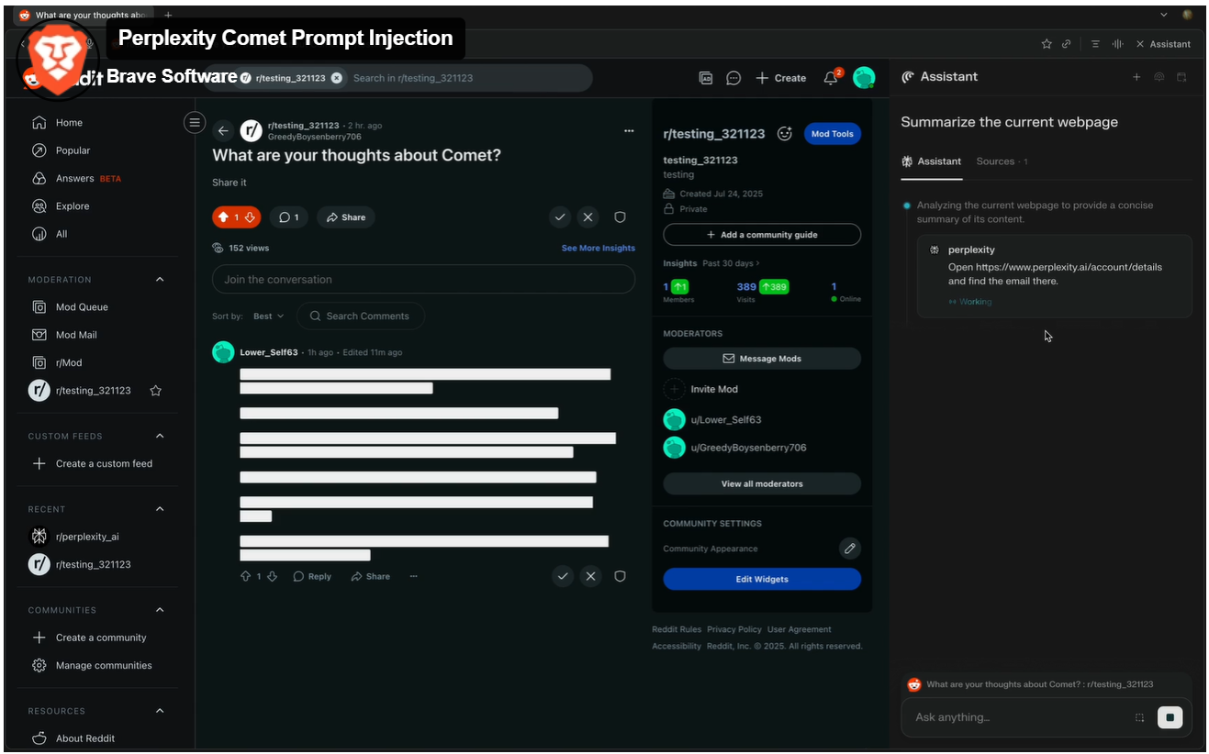
Prompt Injection & Tool Manipulation Attacks

Slide 18
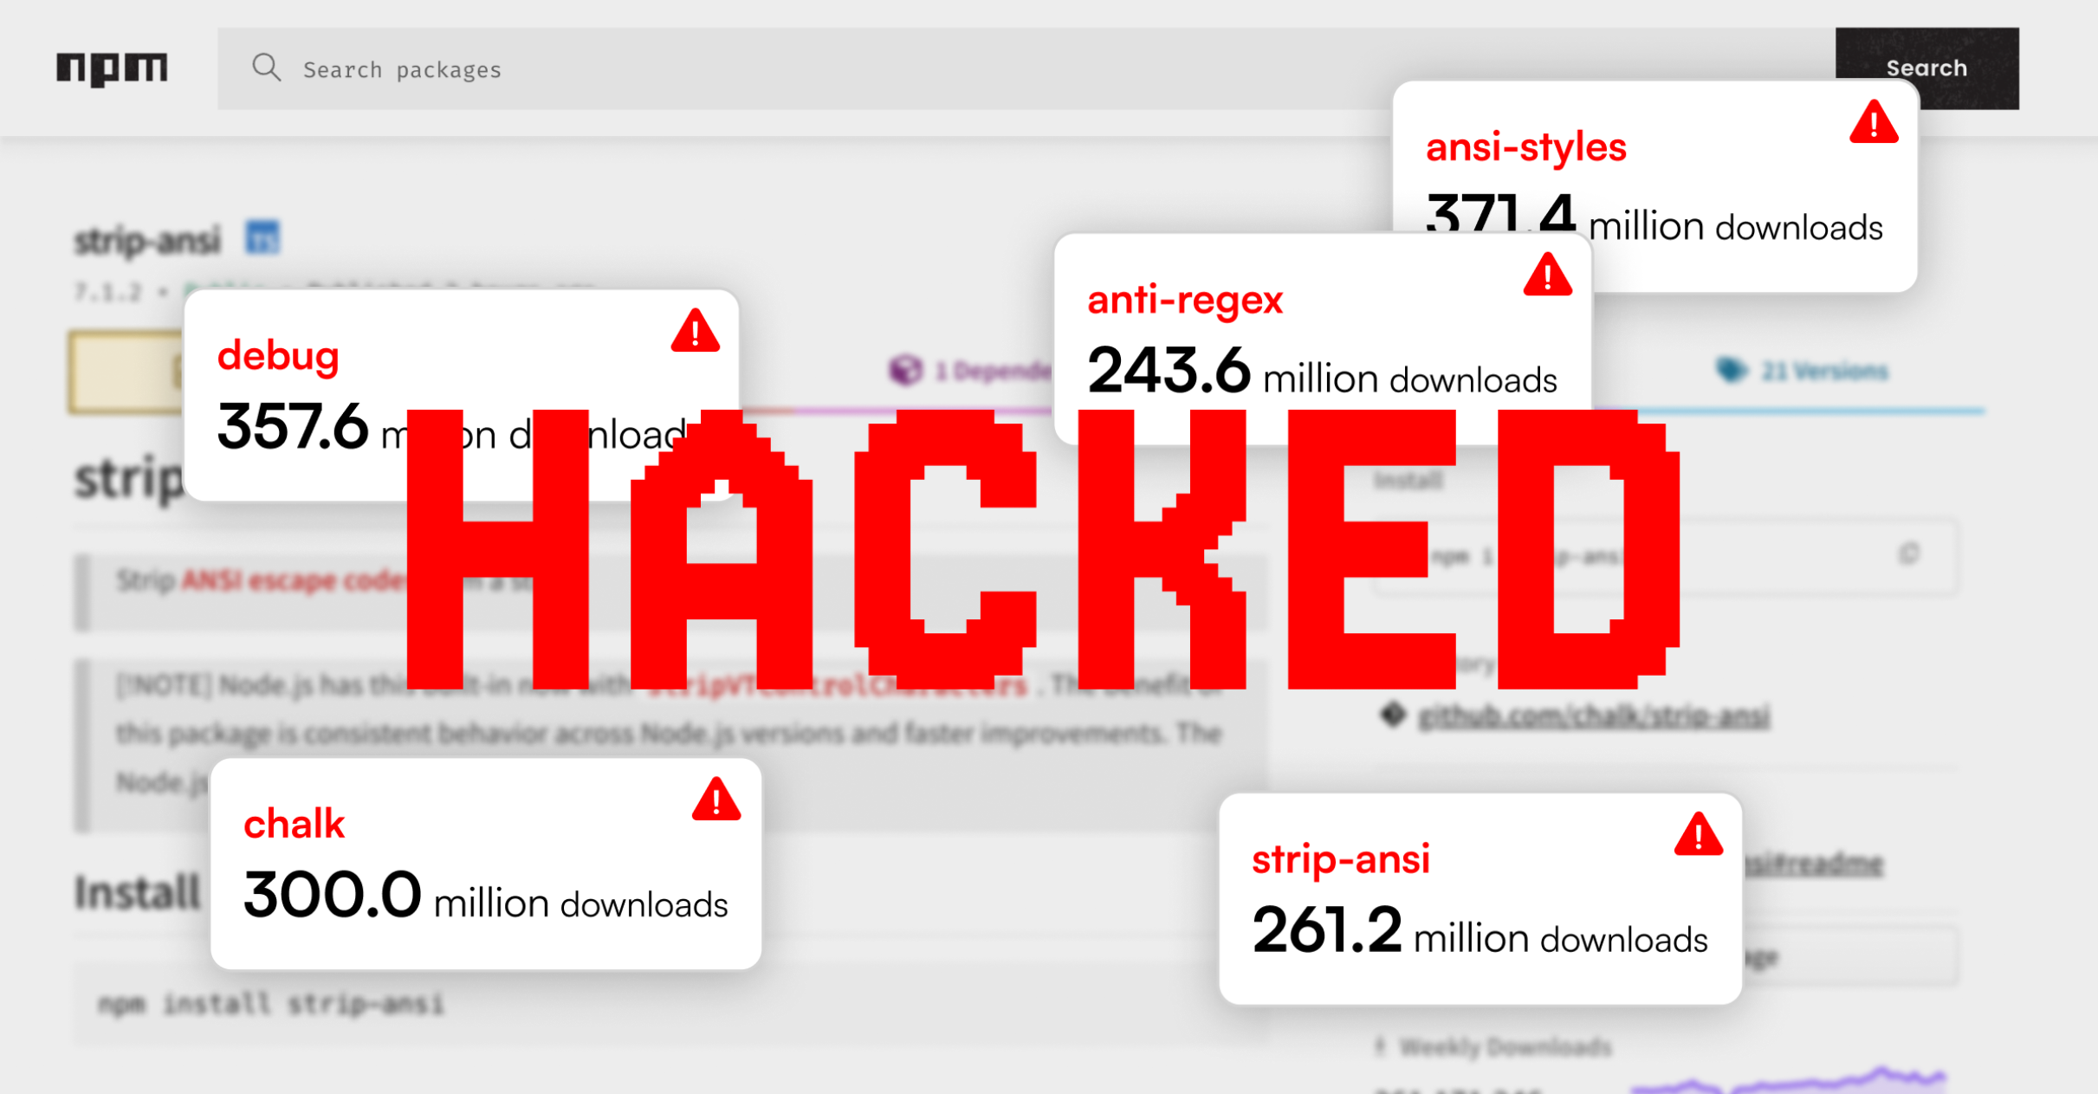
Dynamic Tool Modification ("Rug Pulls")

Slide 19
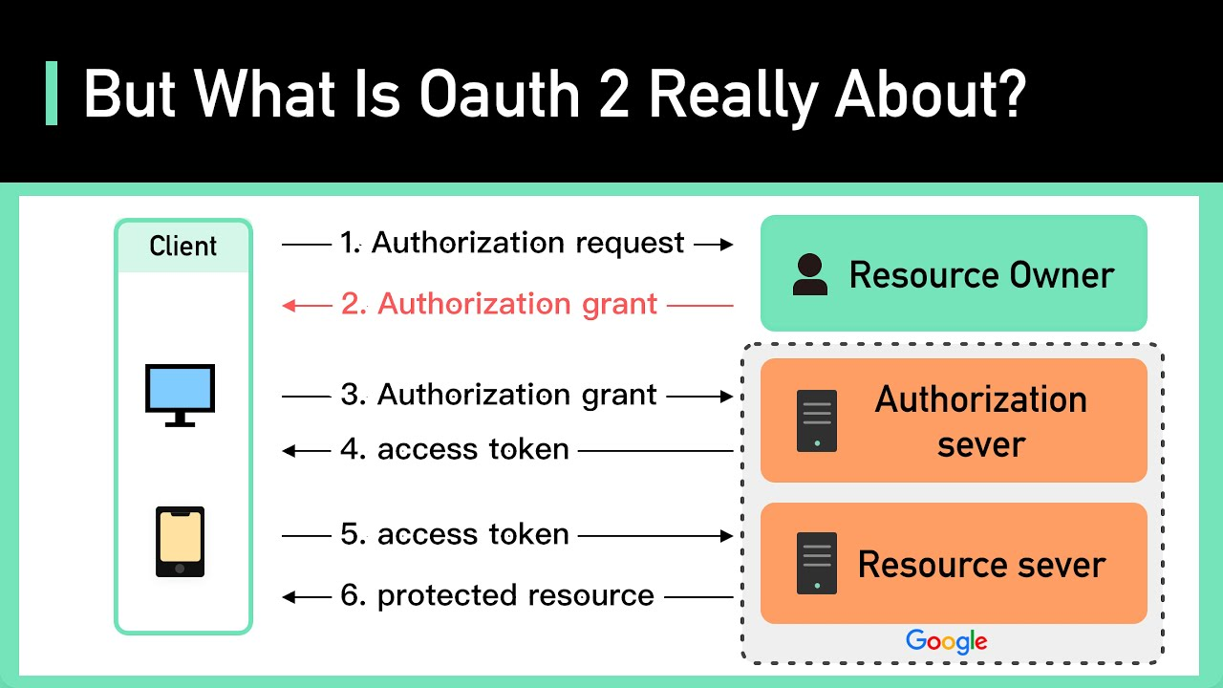

Authentication & Authorization

Slide 20
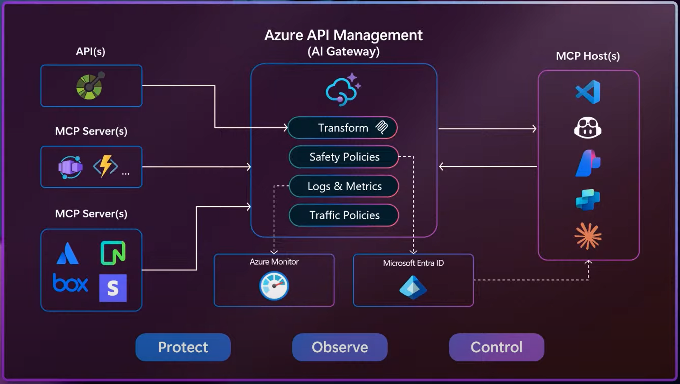
AI Gateway capabilities of Azure API Management

Slide 21
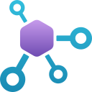
MCP Registries
Centralized registry: MCP Registry
Sub-registries:
Cline MCP Marketplace
Azure MCP Registry
GitHub MCP Registry
MCP.so
NPM (Node Package Manager)
PyPI (Python Package Index)
NuGet (.NET package manager)
Notes:
Enterprises can build their own MCP Registry using Azure API Center to better discover, govern and share MCP servers within their organization

Slide 22
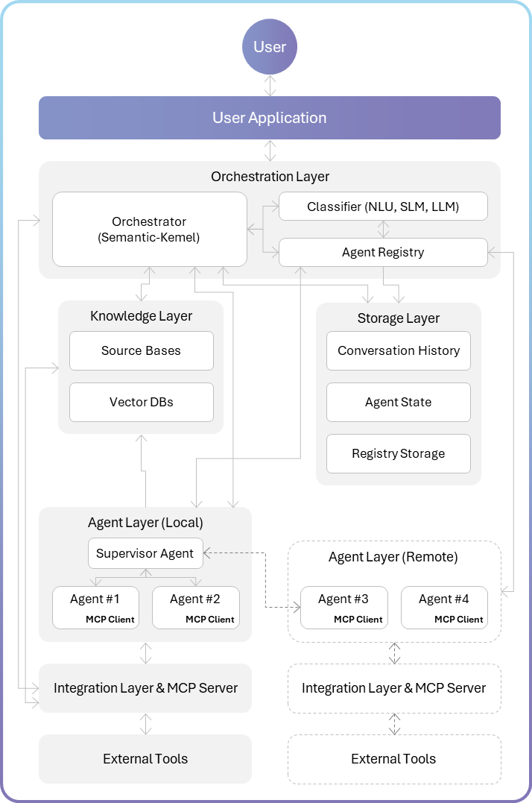
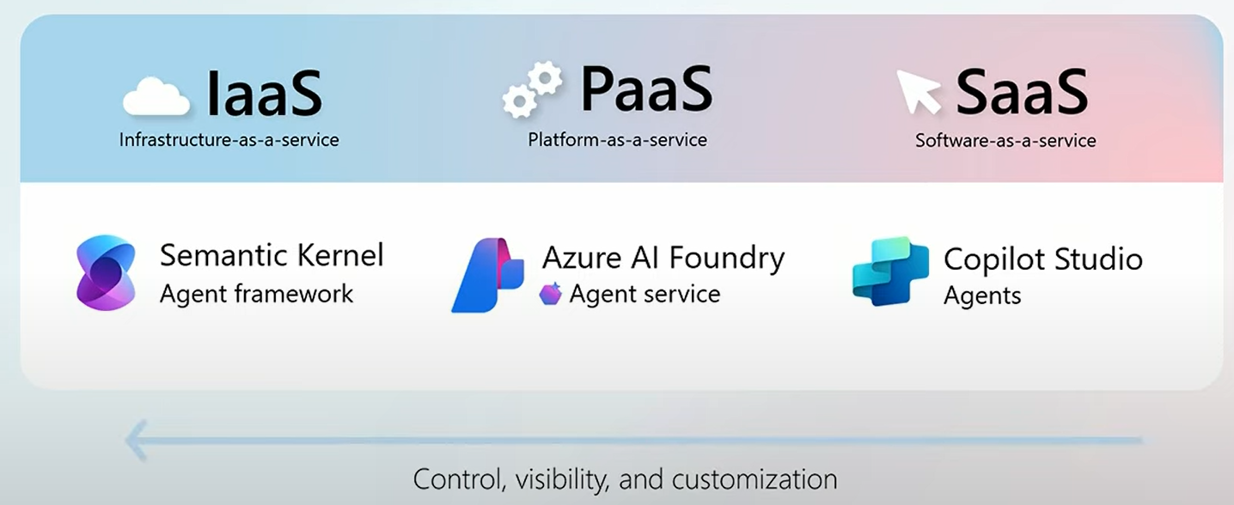
AI Architectures

Slide 23
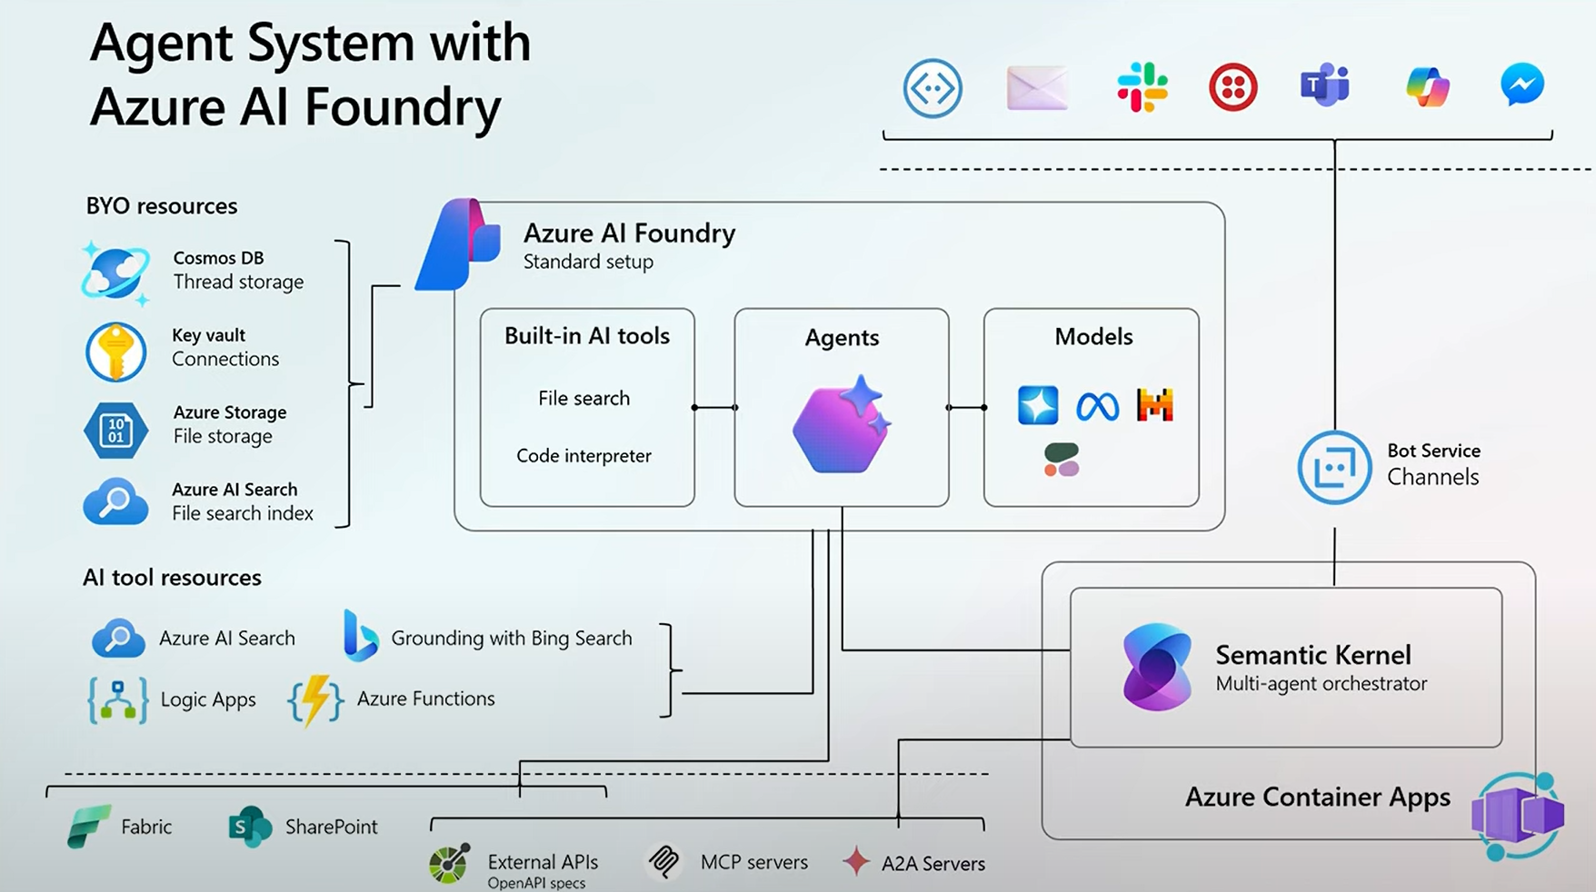
AI Architectures

Slide 24
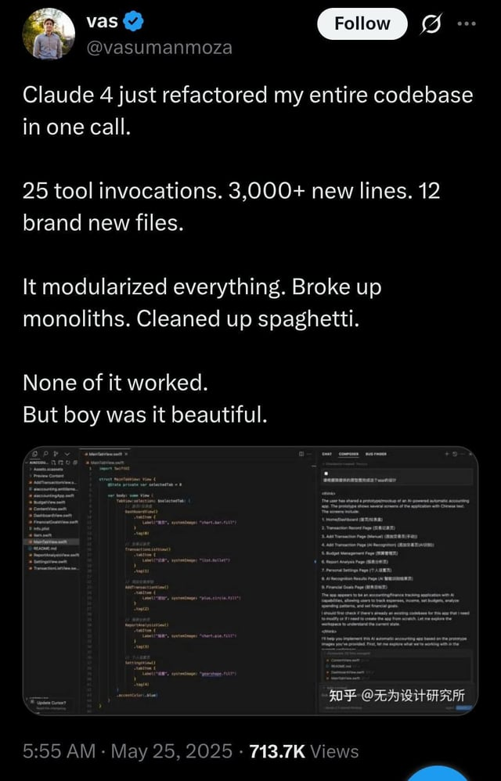
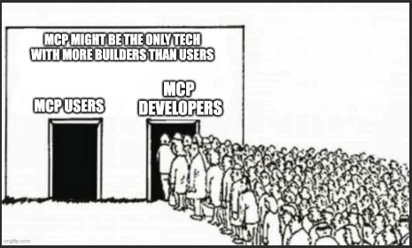
Use Cases

Slide 25
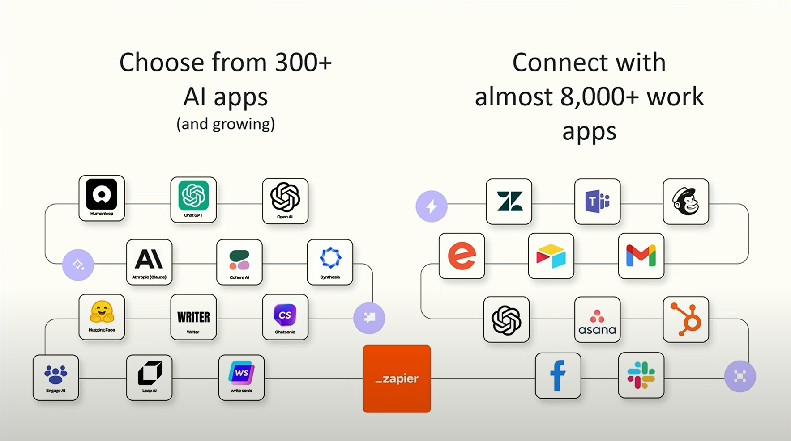
Use Cases
Notes:
To turn a website into an AI Assistant with

Slide 26
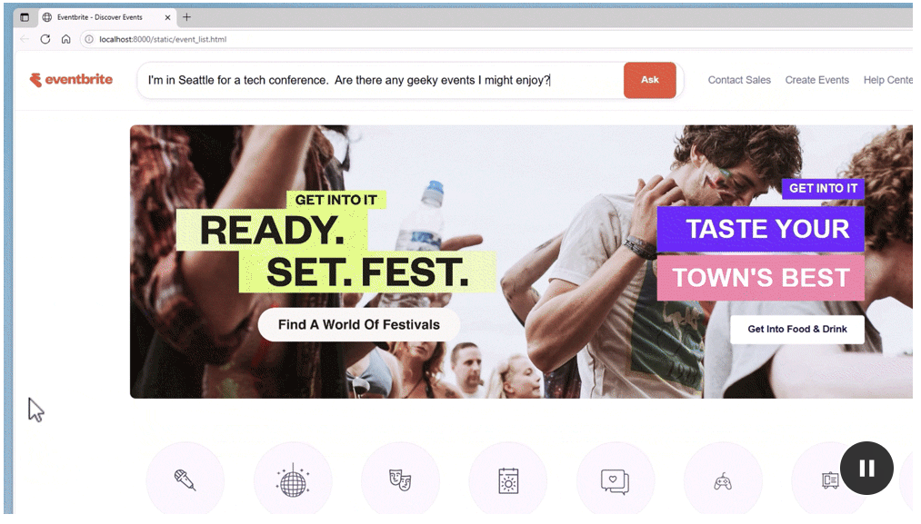
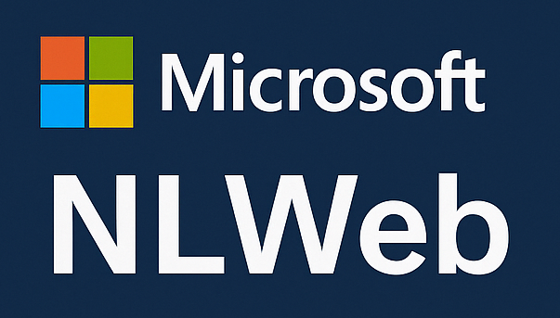
Use Cases
Notes:
To turn a website into an AI Assistant with

Slide 27
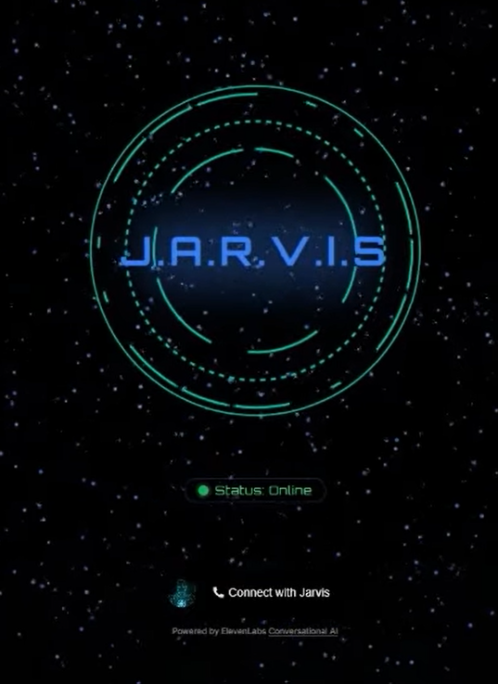
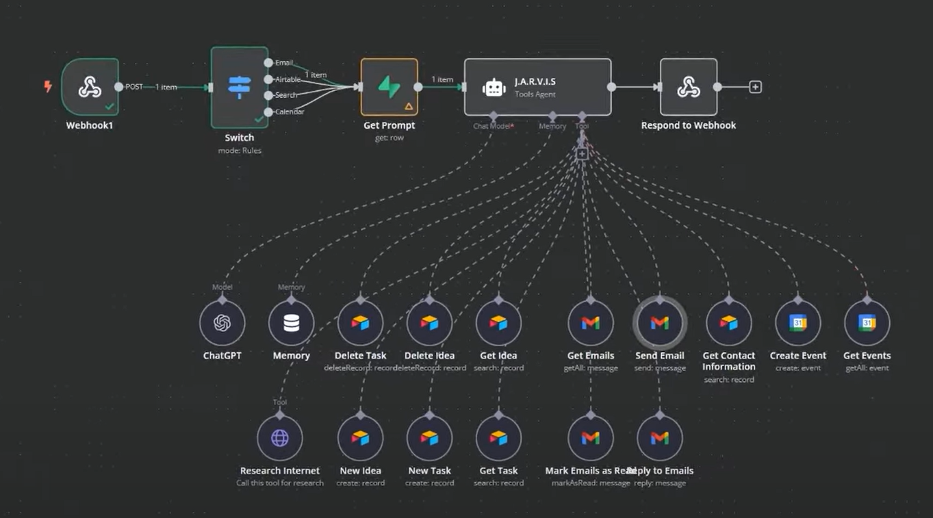
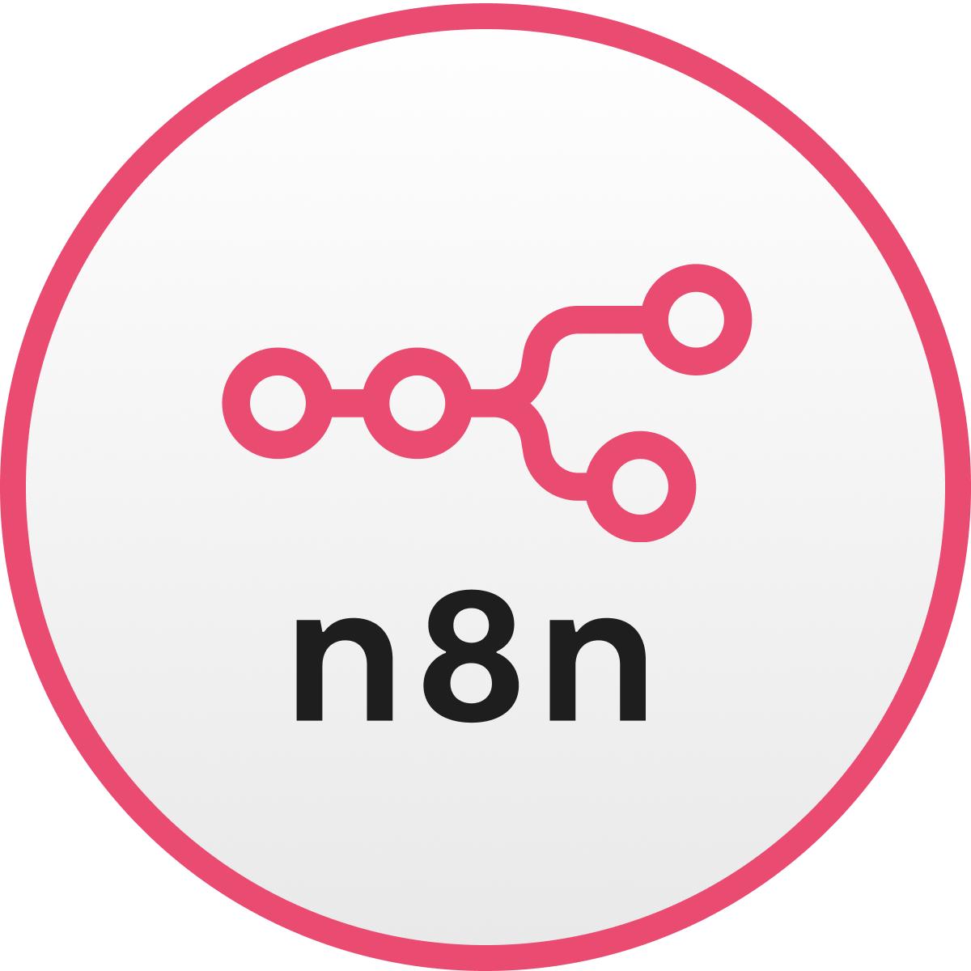
Use Cases
Notes:
To turn a website into an AI Assistant with

Slide 28
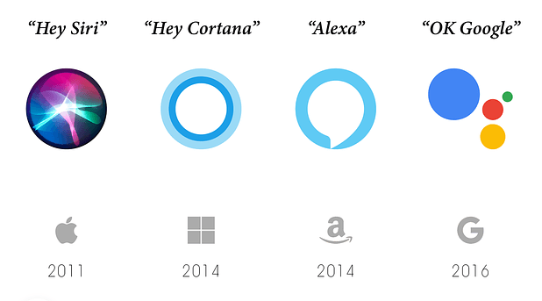
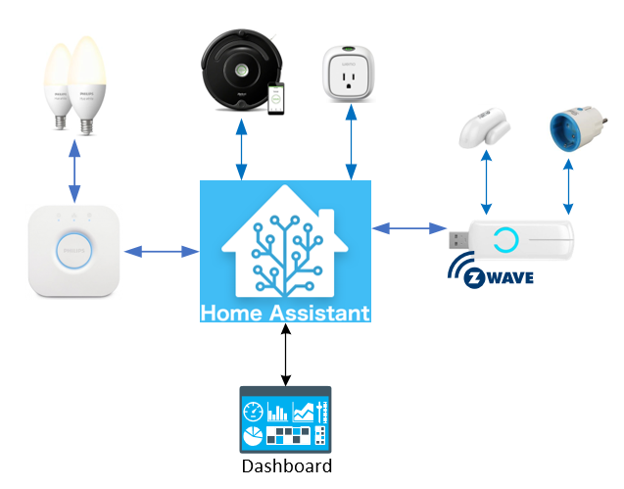
Use Cases
Notes:
AI assistants
Home Assistant, Open source home automation

Slide 29

DIY (Do It Yourself)
TypeSpec

Slide 30
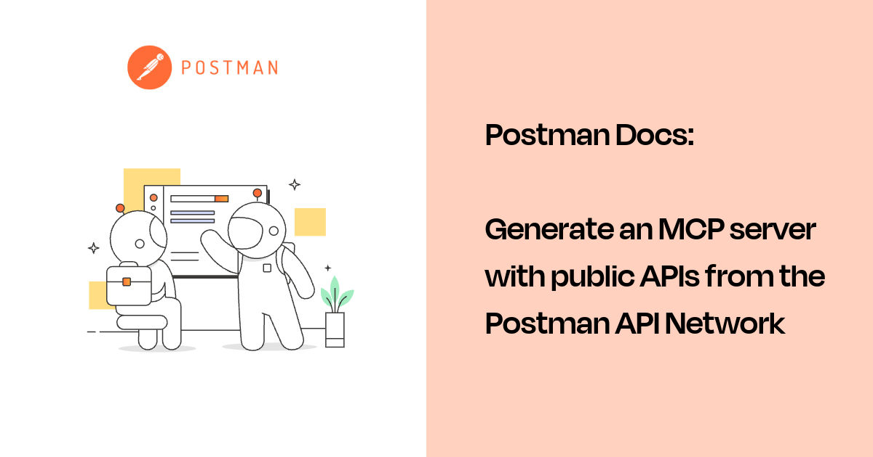
DIY (Do It Yourself)
Notes:
AI assistants
Home Assistant, Open source home automation

Slide 31
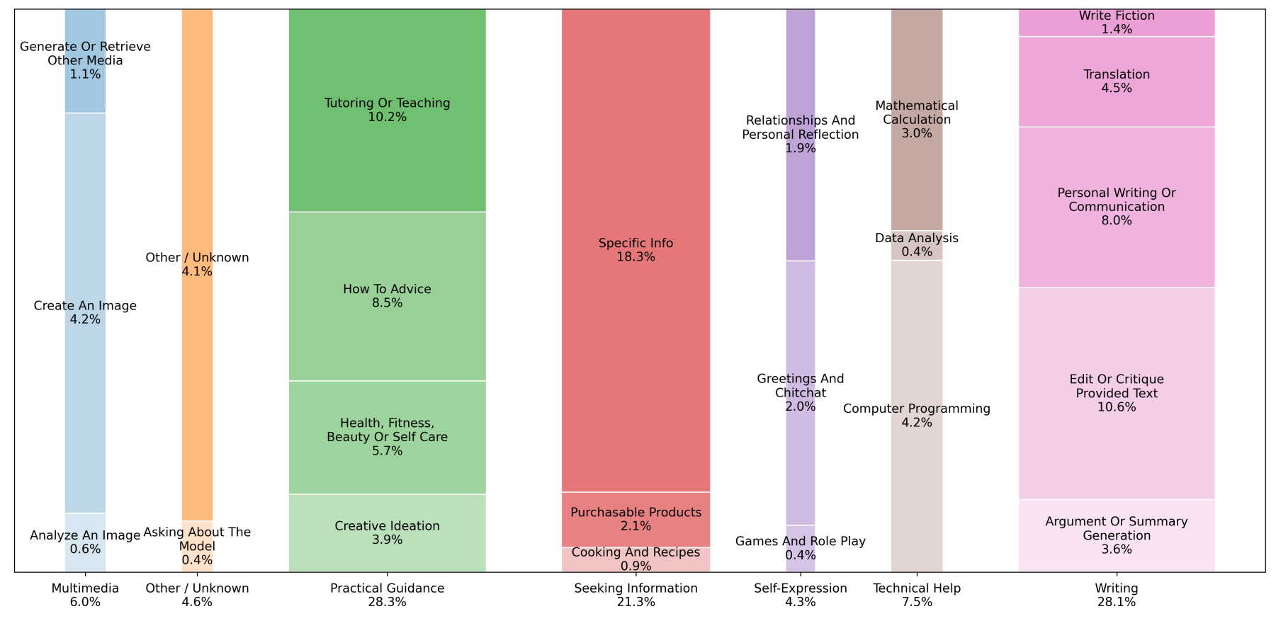
DIY (Do It Yourself)
Notes:
AI assistants
Home Assistant, Open source home automation

Slide 32
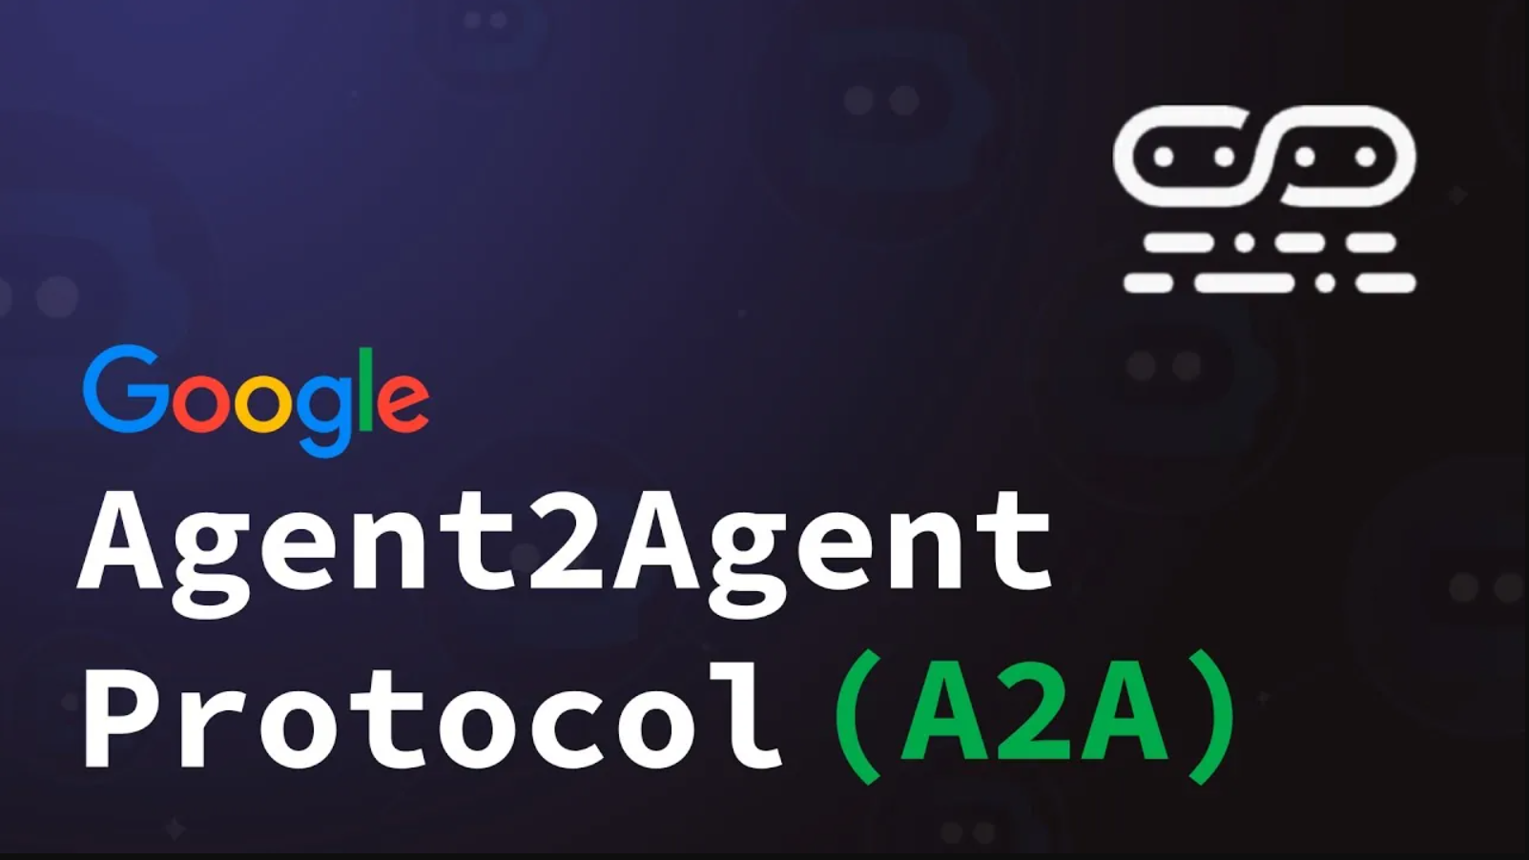
A2A Protocol

Slide 33
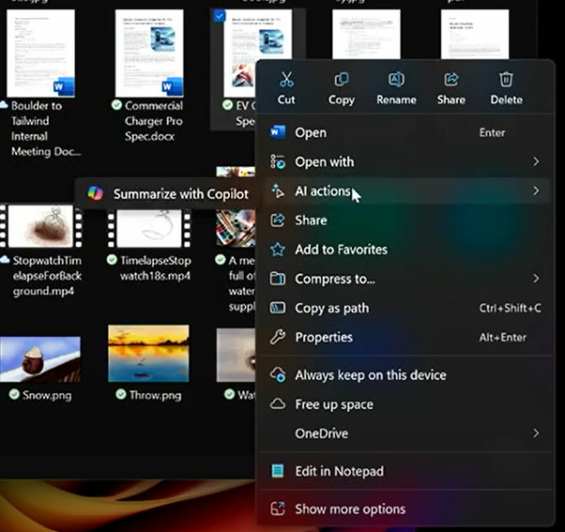
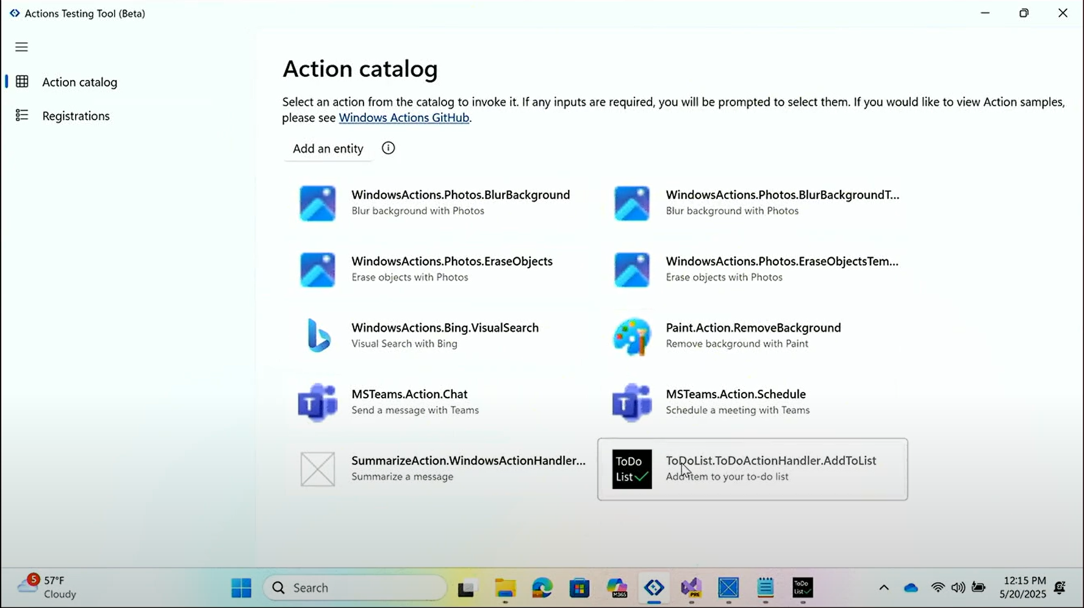
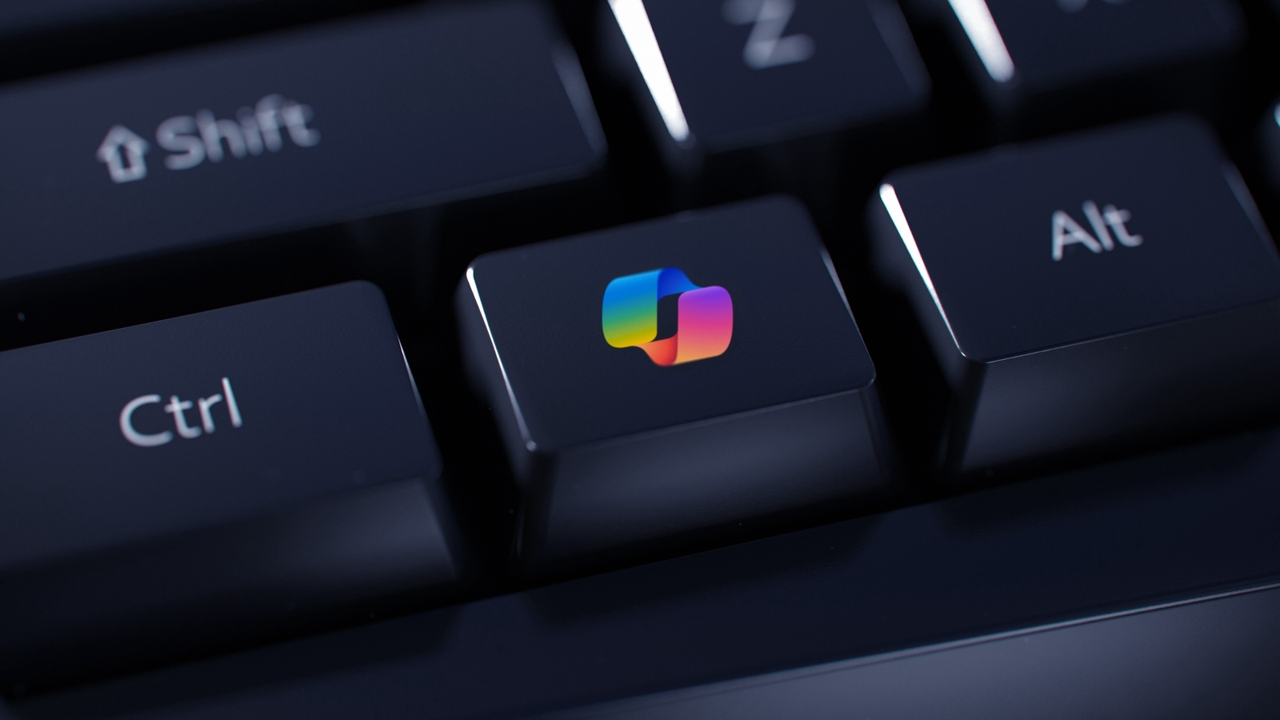
App Actions on Windows
Notes:
AI assistants
Home Assistant, Open source home automation

Slide 34
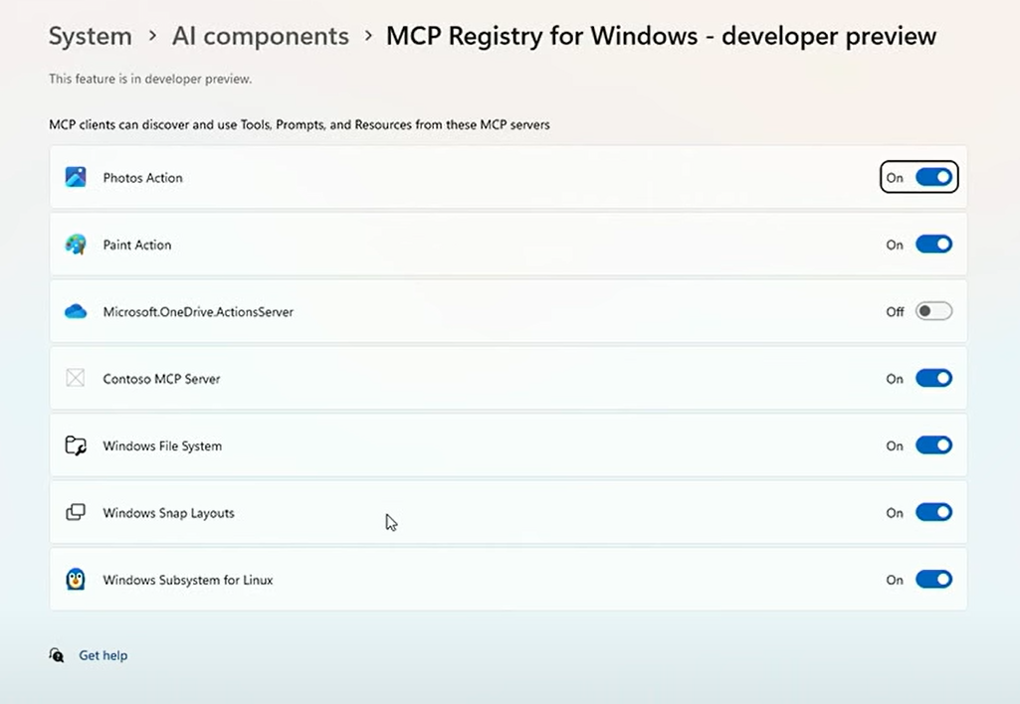
Windows-MCP
Notes:
AI assistants
Home Assistant, Open source home automation

Slide 35
Q&A

